Slide 1



Habitat protection, restoration, and results of population management

Slide 2
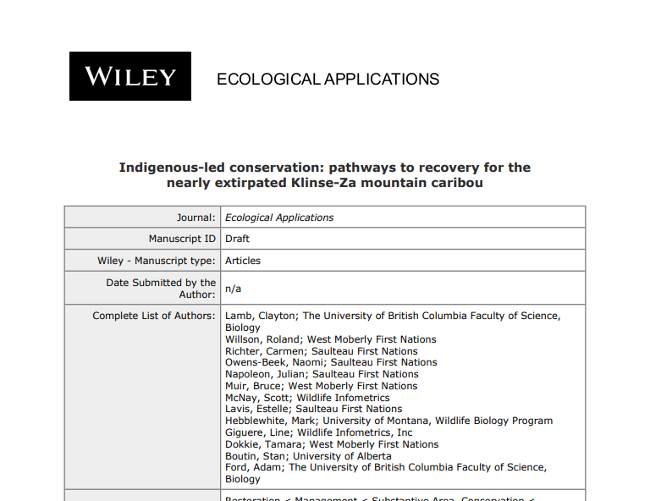

Slide 3
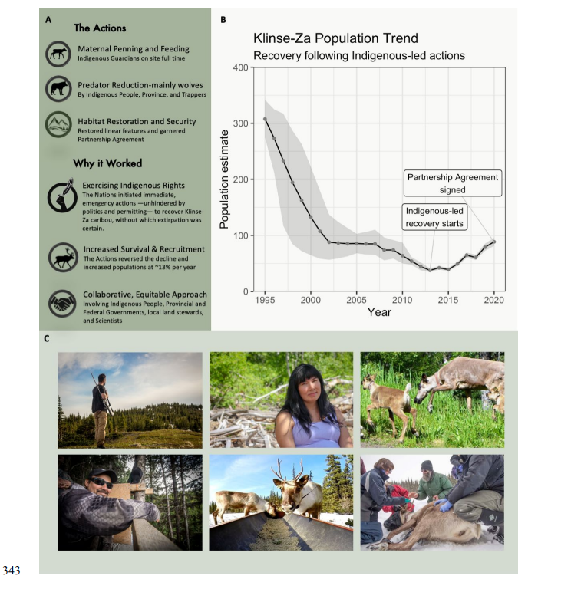

Slide 4
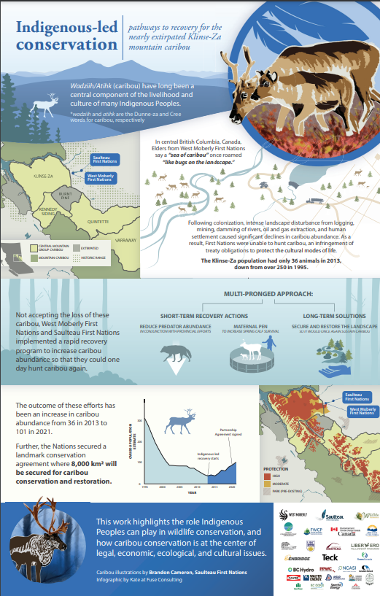

Slide 5
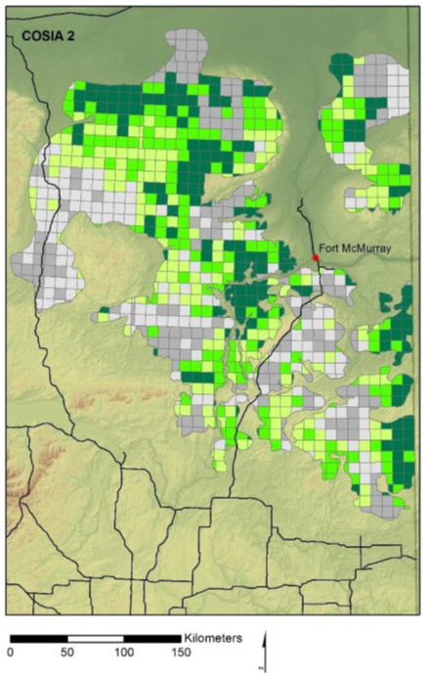
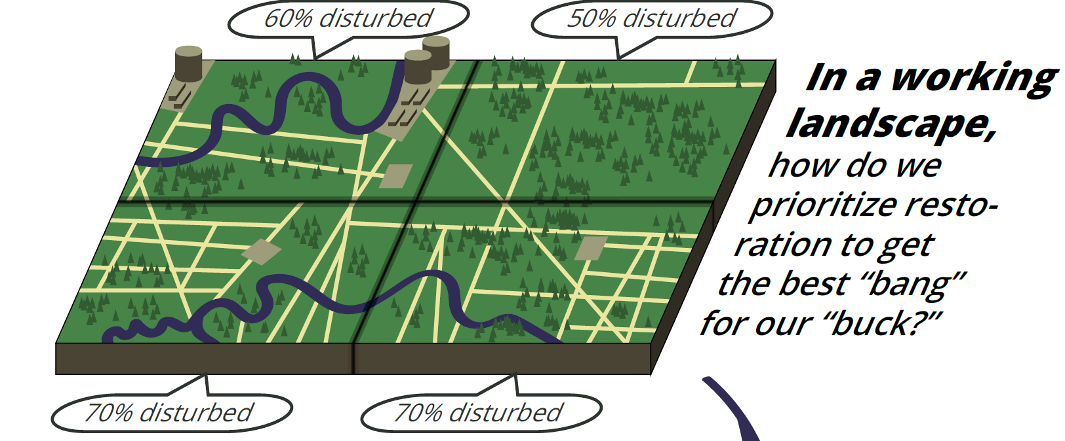
Prioritizing Habitat Restoration
Recognizing the need to prioritize restoration
  Expensive
  Time consuming
Notes:
Notes from COSIA 1.0:
On other data: Several data layers may have been valuable to include but were not available for the entire study area so could not be incorporated. These included the provincial model of caribou resource selection and high intensity LiDAR (Light Detection and Ranging) data. Therefore, an implicit assumption is that caribou habitat quality was treated uniformly throughout each caribou range. However, a sensitivity analysis done as part of a separate project (ABMI 2015) revealed that caribou habitat quality affected only a minor component of restoration planning, likely because scaling up to the township level masked small scale variation in habitat quality.
On scale: This approach ignores fine scale variation in line density and configuration, but is appropriate for coarse-filter strategic planning, as it may simplify logistics for on-the-ground work. It is likely that a subsequent process is required for fine scale operation and tactical planning.
On current disturbance: non-candidate or not available for restoration in the near term, including roads (year round and seasonal), active pipelines, central processing facilities, and commercial well pads. OSIP boundaries (+500m) were removed when calculating the reduction of footprint
On future disturbance: 1-RVL/MaxRVL (inverse normalized RVL)
On Optimization: Compared to Van Rensen’s optimiazation, and results were very similar (because both had similar inputs)s.
Alternate analyses: Only outside of active petroleum and natural gas agreements, current active oil sands agreements, and Forest Management Areas. Tenure does not imply surface disturbance.

Slide 6
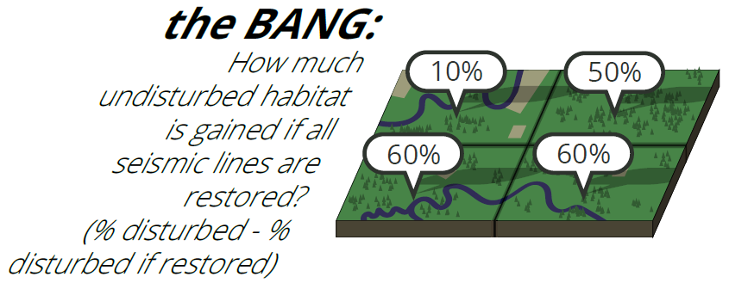
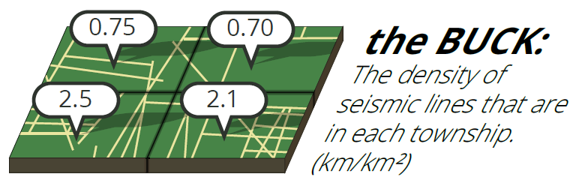
The Approach:

Slide 7
The Approach:
“no-go” zones

Slide 8
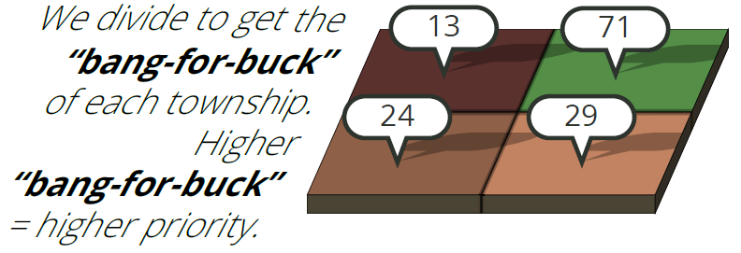
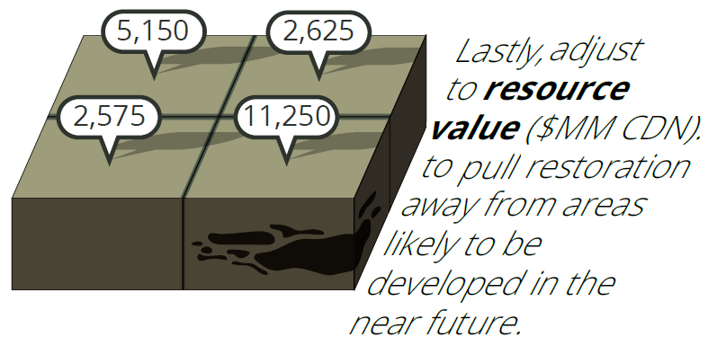
The Approach:

Slide 9
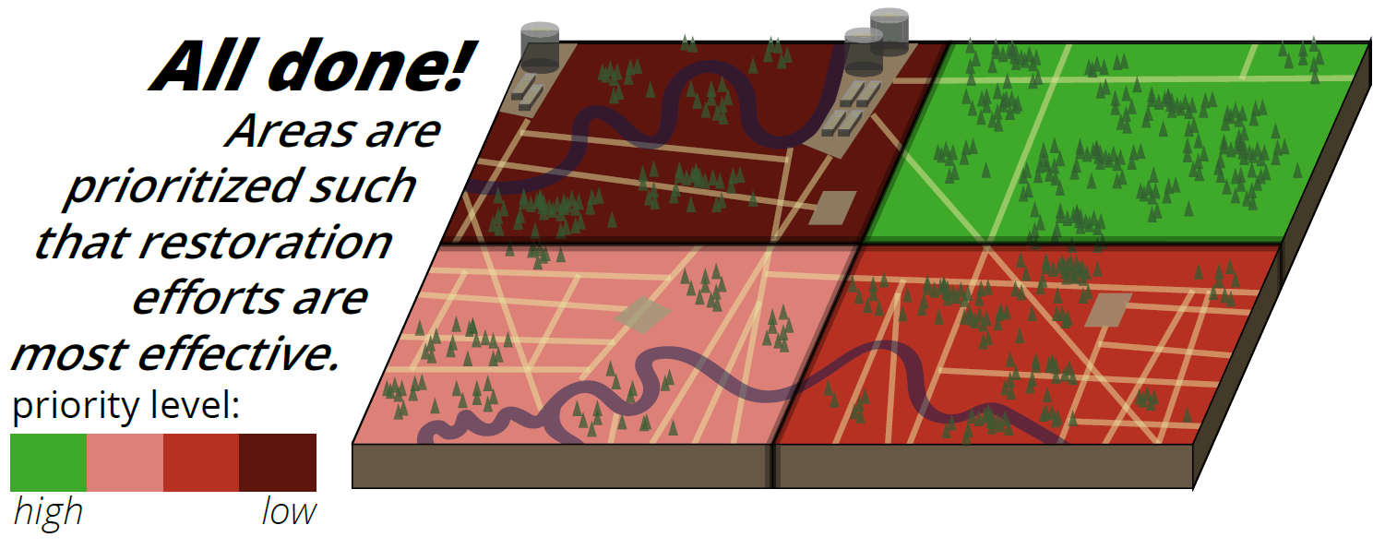
The Approach:

Slide 10
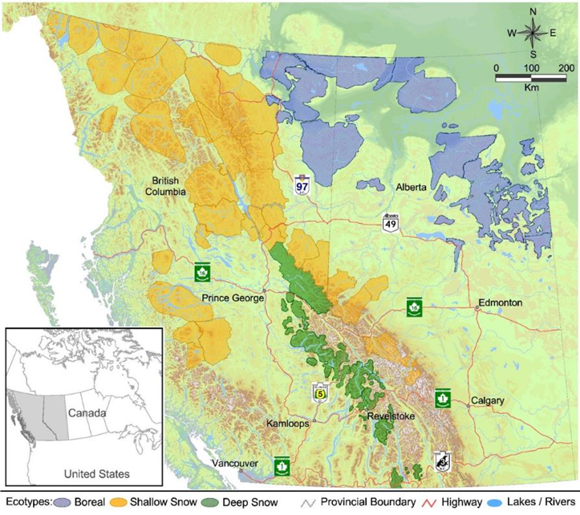
Modifying the approach

Slide 11
Modifying the approach

Slide 12
Modifying the approach

Slide 13
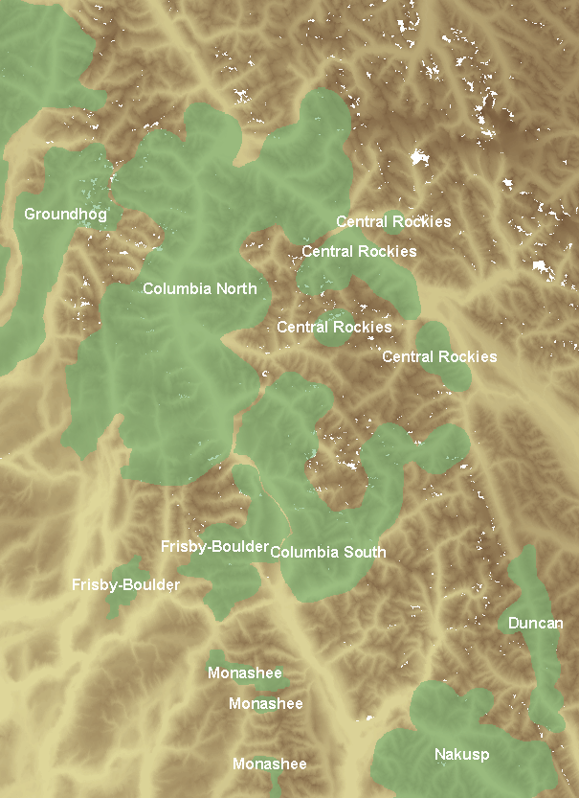
Study Area

Slide 14
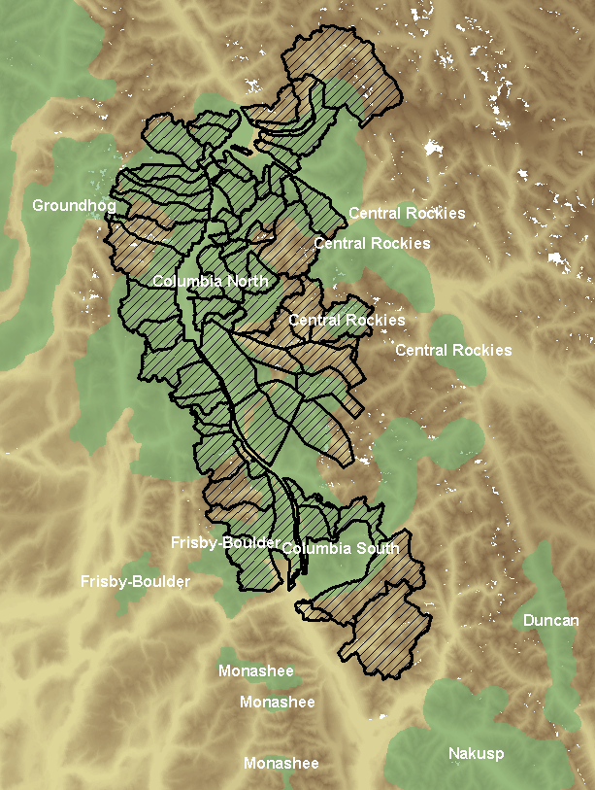
Study Area

Slide 15
Prioritization “algorithm”
Habitat Gain
%Disturbed
=
Cost
Restorable Road Density

Slide 16
Prioritization “algorithm”
Habitat Gain
%Disturbed
=
Cost
Restorable Road Density
Average Caribou Use
Proportion Core Caribou Habitat
Proportion GAR
Proportion Moose Disturbance

Slide 17
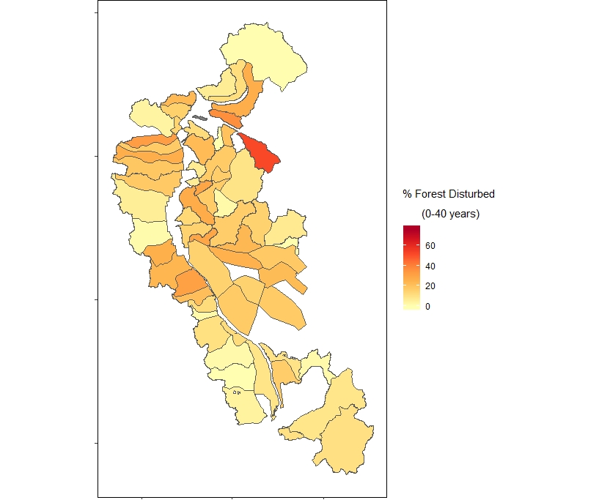
Calculate Disturbance
*Preliminary

Slide 18
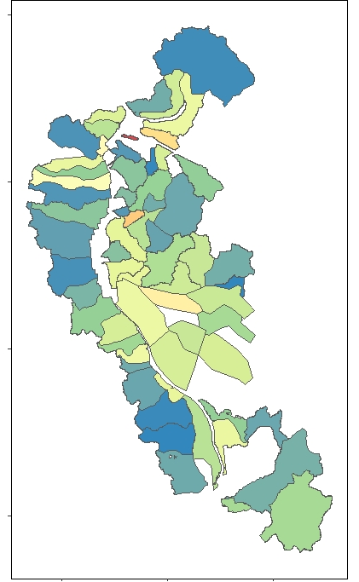
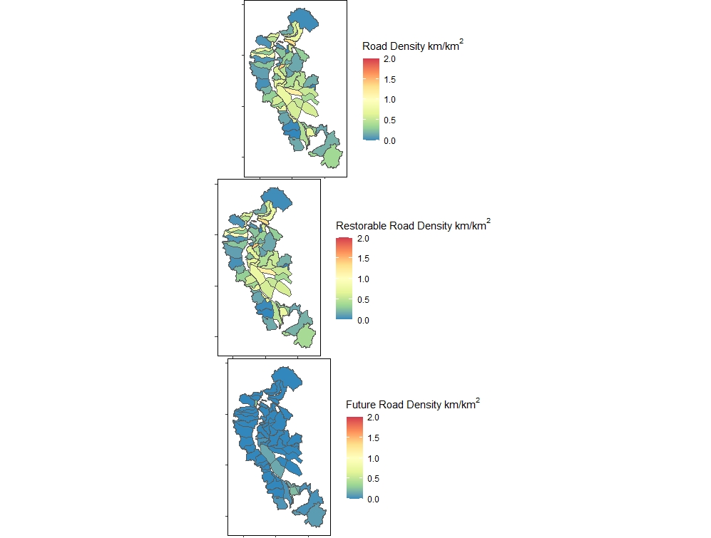
Calculate “Cost”
*Preliminary

Slide 19
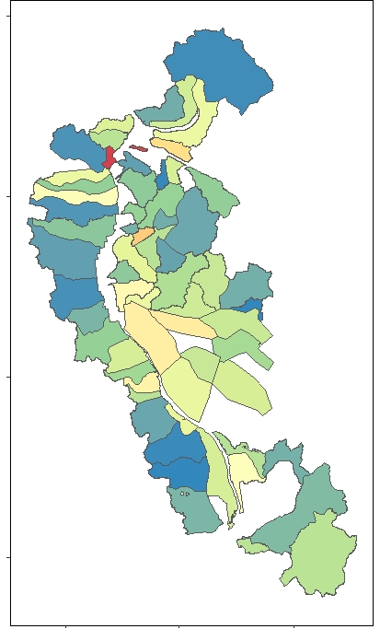
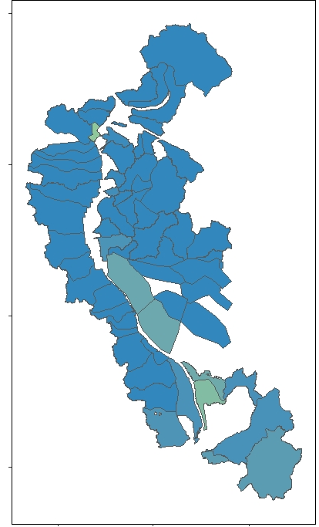
Calculate “Cost”
*Preliminary
Total
Restorable
Permanent

Slide 20
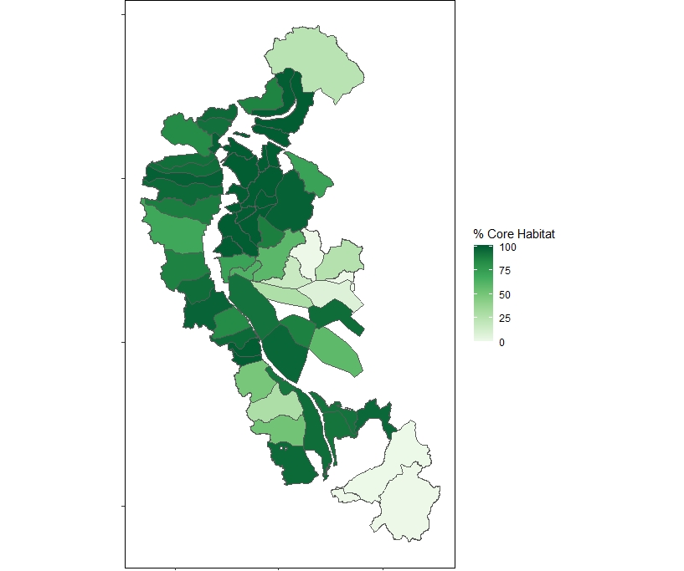
Add weightings – Core Habitat
*Preliminary

Slide 21
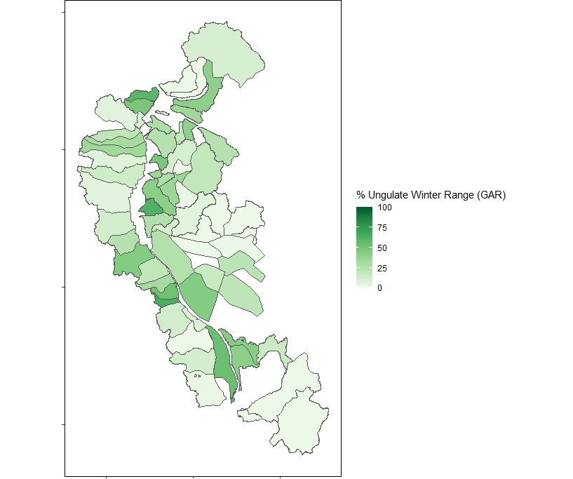
Add weightings – GAR
*Preliminary

Slide 22
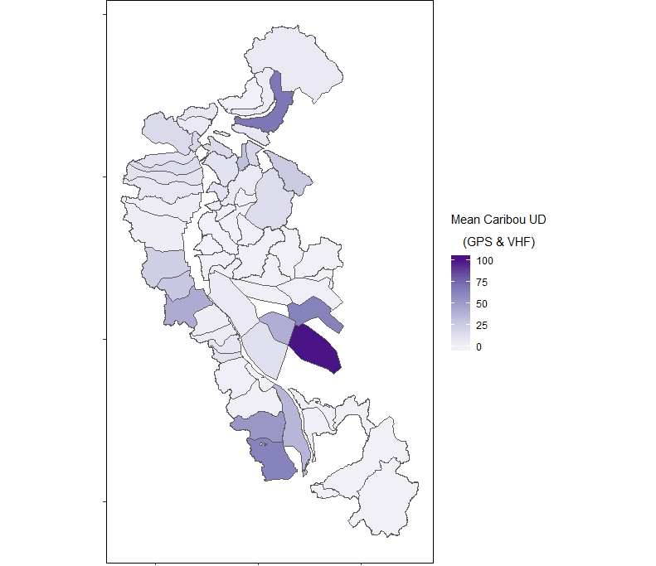
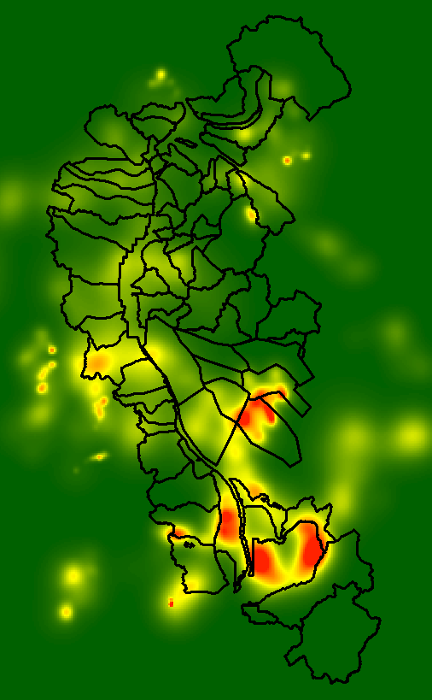
Add weightings – Caribou Use
*Preliminary

Slide 23
Add weightings – Caribou Use
*Preliminary

Slide 24
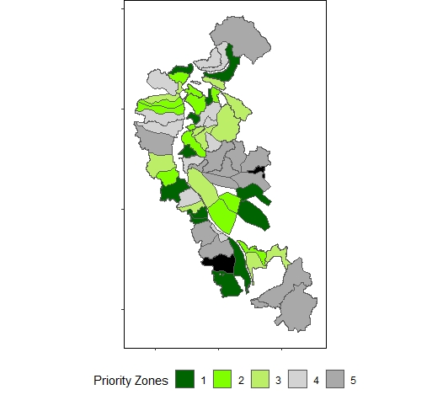
Priority Zones
Priority =
% Disturbance (0-40 years)
Restorable Road Density
Weightings:
+ Caribou Use
+ Core Caribou Range
+ Ungulate Winter Range
+ 1- Forest Disturbance 0-20
Black units are not candidates for restoration
due to the absence of restorable roads

Slide 25
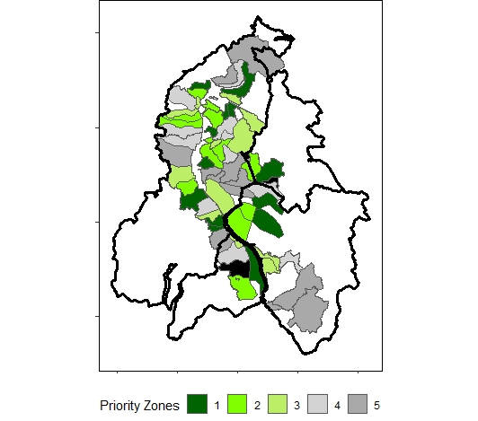
Priority Zones by Herd
Priority =
% Disturbance (0-40 years)
Restorable Road Density
Weightings:
+ Caribou Use
+ Core Caribou Range
+ GAR protection
+ 1- Forest Disturbance 0-20
Black units are not candidates for restoration
due to the absence of restorable roads

Slide 26
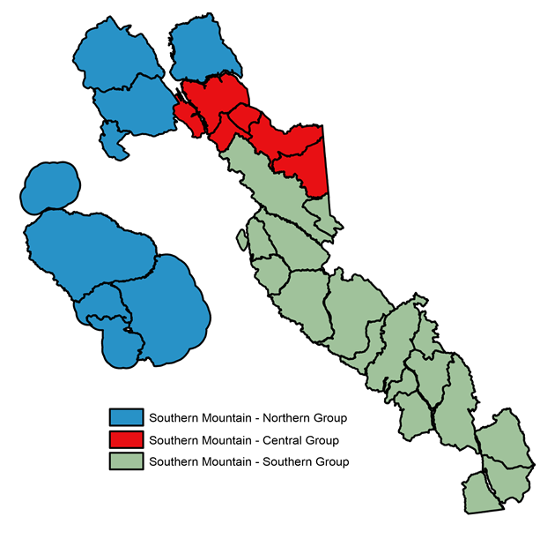
An evolving process
Priority =
% Disturbance (0-40 years)
Restorable Road Density
Weightings:
+ Caribou Use
+ Core Caribou Range
+ Ungulate Winter Range
+ 1- Forest Disturbance 0-20
Black units are not candidates for restoration
due to the absence of restorable roads

Slide 27
Operational Considerations
Hierarchical decisions
  By Range, within range, line-level
Not all roads are equal
  Some roads may already be recovering
  Some roads may be more difficult to access, or more costly to treat
  Some roads may need additional roads be built for access
Road stranding
  restoring specific roads may cut off access to other roads that also need treatments
Other land-use considerations
  First Nation communities may prioritize specific areas
  Recreational use

